Slide 1
2024
Project name: Emhare HotMail
Colleen Marasha R216919W HCE205

Slide 2

Introduction
In a digital landscape that is becoming more intertwined, the significance
of privacy and anonymity has escalated, alongside the necessity of protecting freedom of expression. Those who voice opposing viewpoints or disclose sensitive information may encounter serious repercussions due to various social, religious, political, and personal circumstances,
underscoring the need for confidential communication. It is crucial
to give these individuals the tools to express their ideas and
experiences without the constant threat of persecution. Their voices
could potentially lead to the exposure of authoritarian governments,
crime, abuse, or areas where censorship is prevalent by offering a
secure platform for whistleblowers and activists. 🦺

Slide 3

Problem Statement.
Students from marginalized groups at the University of Zimbabwe experience neglect, crime, and abuse while remaining silent due to fear of retaliation, stigma, harassment, and discrimination. This situation can lead to heightened feelings of hopelessness, frustration, and decreased academic performance.

Slide 4



Existing Systems.
Currently, the following methods of safe reporting are in place:
SRC board
Police report
Suggestion Box
Letter to trusted Administrator
Peer Support office
However,
All the mentioned ways here, require the victim to be present hence decreasing the chance of anonymous reporting hence exposing him/her to humiliation or harassment.

Slide 5
Gaps Identified
Lack of anonymity
Protection of identity after reporting sensitive offenses
Allowance to share hard evidence of offence
These gaps are present in the current Systems

Slide 6
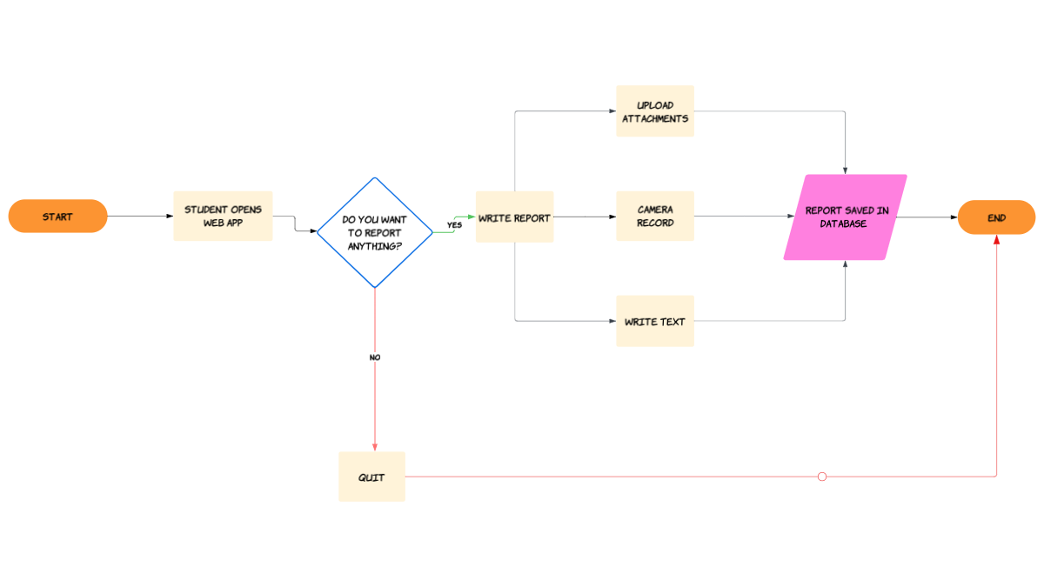
Proposed Solution
Proposed Solution.
Creating a Web Application for the University of Zimbabwe Students where they can report in comfort and privacy about any issues.
Solution,
Creating a Web Application for the University of Zimbabwe Students where they can report in comfort and privacy about any issues.

Slide 7
1. Aim
To design and implement a computerised Anonymous Reporting Web Application
for the University of Zimbabwe,
enhancing the effectiveness
of Reporting services for
students whilst
protecting
victims
identities.

Slide 8
2. Objectives
The Web App should do the following:
User Interface: Should be user-friendly, easy to navigate on PC, android and OS
Storage: All reports should be stored in a single database
User Experience: The student should be able to upload text, audio, images or record data and send it as part of the Report

Slide 9
1. Technologies
Design Tools that were used:
Front-end React JS framework, HTML, CSS
Back-end Node JS, Postgres SQl
Mobile Application Javascript, React Native, ExpoGo

Slide 10

Future changes and Innovations
Security to limit abuse of the web page
Protocols to limit each student from sending too many emails
Consider board of people to take action towards the reports
Tip
These innovations are highlights of the Website disadvantages currently.

Slide 11
Current Users
Username | Password
ADMIN | password
Codza | 1234567
Sola | 1111111 (seven 1s)
Mimie | 0000000 (seven 0s)

